Slide 1
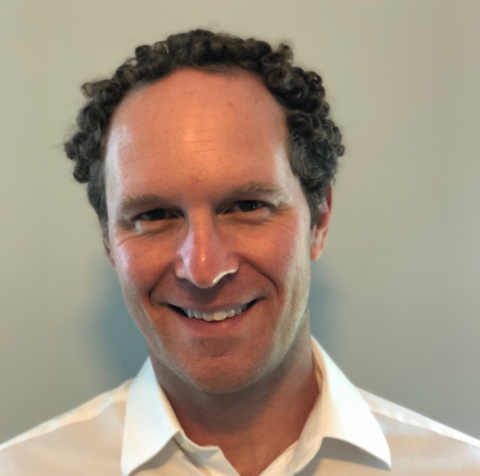
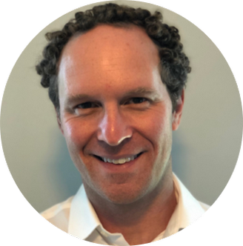
ISDA Virtual Conference: Introduction to Equity Derivatives
Tuesday, November 12, 2024
Equity Derivatives Products
9:05 AM – 10:15 AM EST
Miller Brownstein
Michael A. Caravella
Michelangelo de Marzio
Doug Shaw
Director and
Assistant General Counsel
Bank of America
Director and
Associate General Counsel
Citi
Director,
Derivatives Product Management
ISDA
Partner
Linklaters LLP
®ISDA is a registered trademark of the International Swaps and Derivatives Association, Inc.
Copyright © 2024 International Swaps and Derivatives Association, Inc.

Slide 2
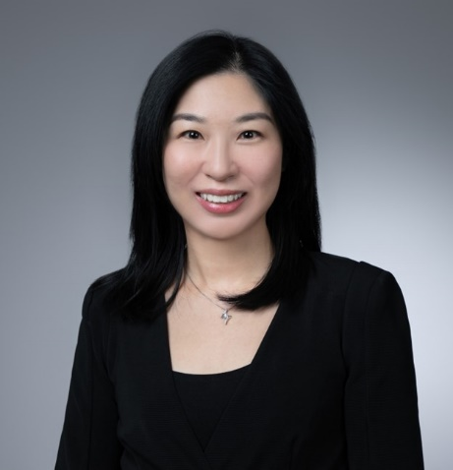
ISDA Virtual Conference: Introduction to Equity Derivatives
Tuesday, November 12, 2024
Introduction to ISDA Equity Derivatives Documentation
10:45 AM – 11:20 AM EST
Miller Brownstein
Monica Chiu
Director and Assistant General Counsel
Bank of America
Senior Counsel, Asia Pacific
ISDA
®ISDA is a registered trademark of the International Swaps and Derivatives Association, Inc.
Copyright © 2024 International Swaps and Derivatives Association, Inc.

